Slide 1
North American Chinatown Smoke Free Day 北美華埠戒煙日
An Activity of the Federation of Chinese American &
Chinese Canadian Medical Societies
Sponsored by FCMS Foundation

Slide 2
North American Chinatown Smoke Free Day 北美華埠戒煙日
Speaker Information Slide

Slide 3
North American Chinatown Smoke Free Day 北美華埠戒煙日
This presentation was prepared by
Chinese American Medical Society, New York
Maggie Chen
Warren W. Chin, M.D., Executive Director
With Support From Charles B. Wang Community Health Center, New York
Rachelle Ocampo, Associate Director of Health Education
Regina Lee, F. Lee, J.D., Executive Vice President of Public Affairs

Slide 4
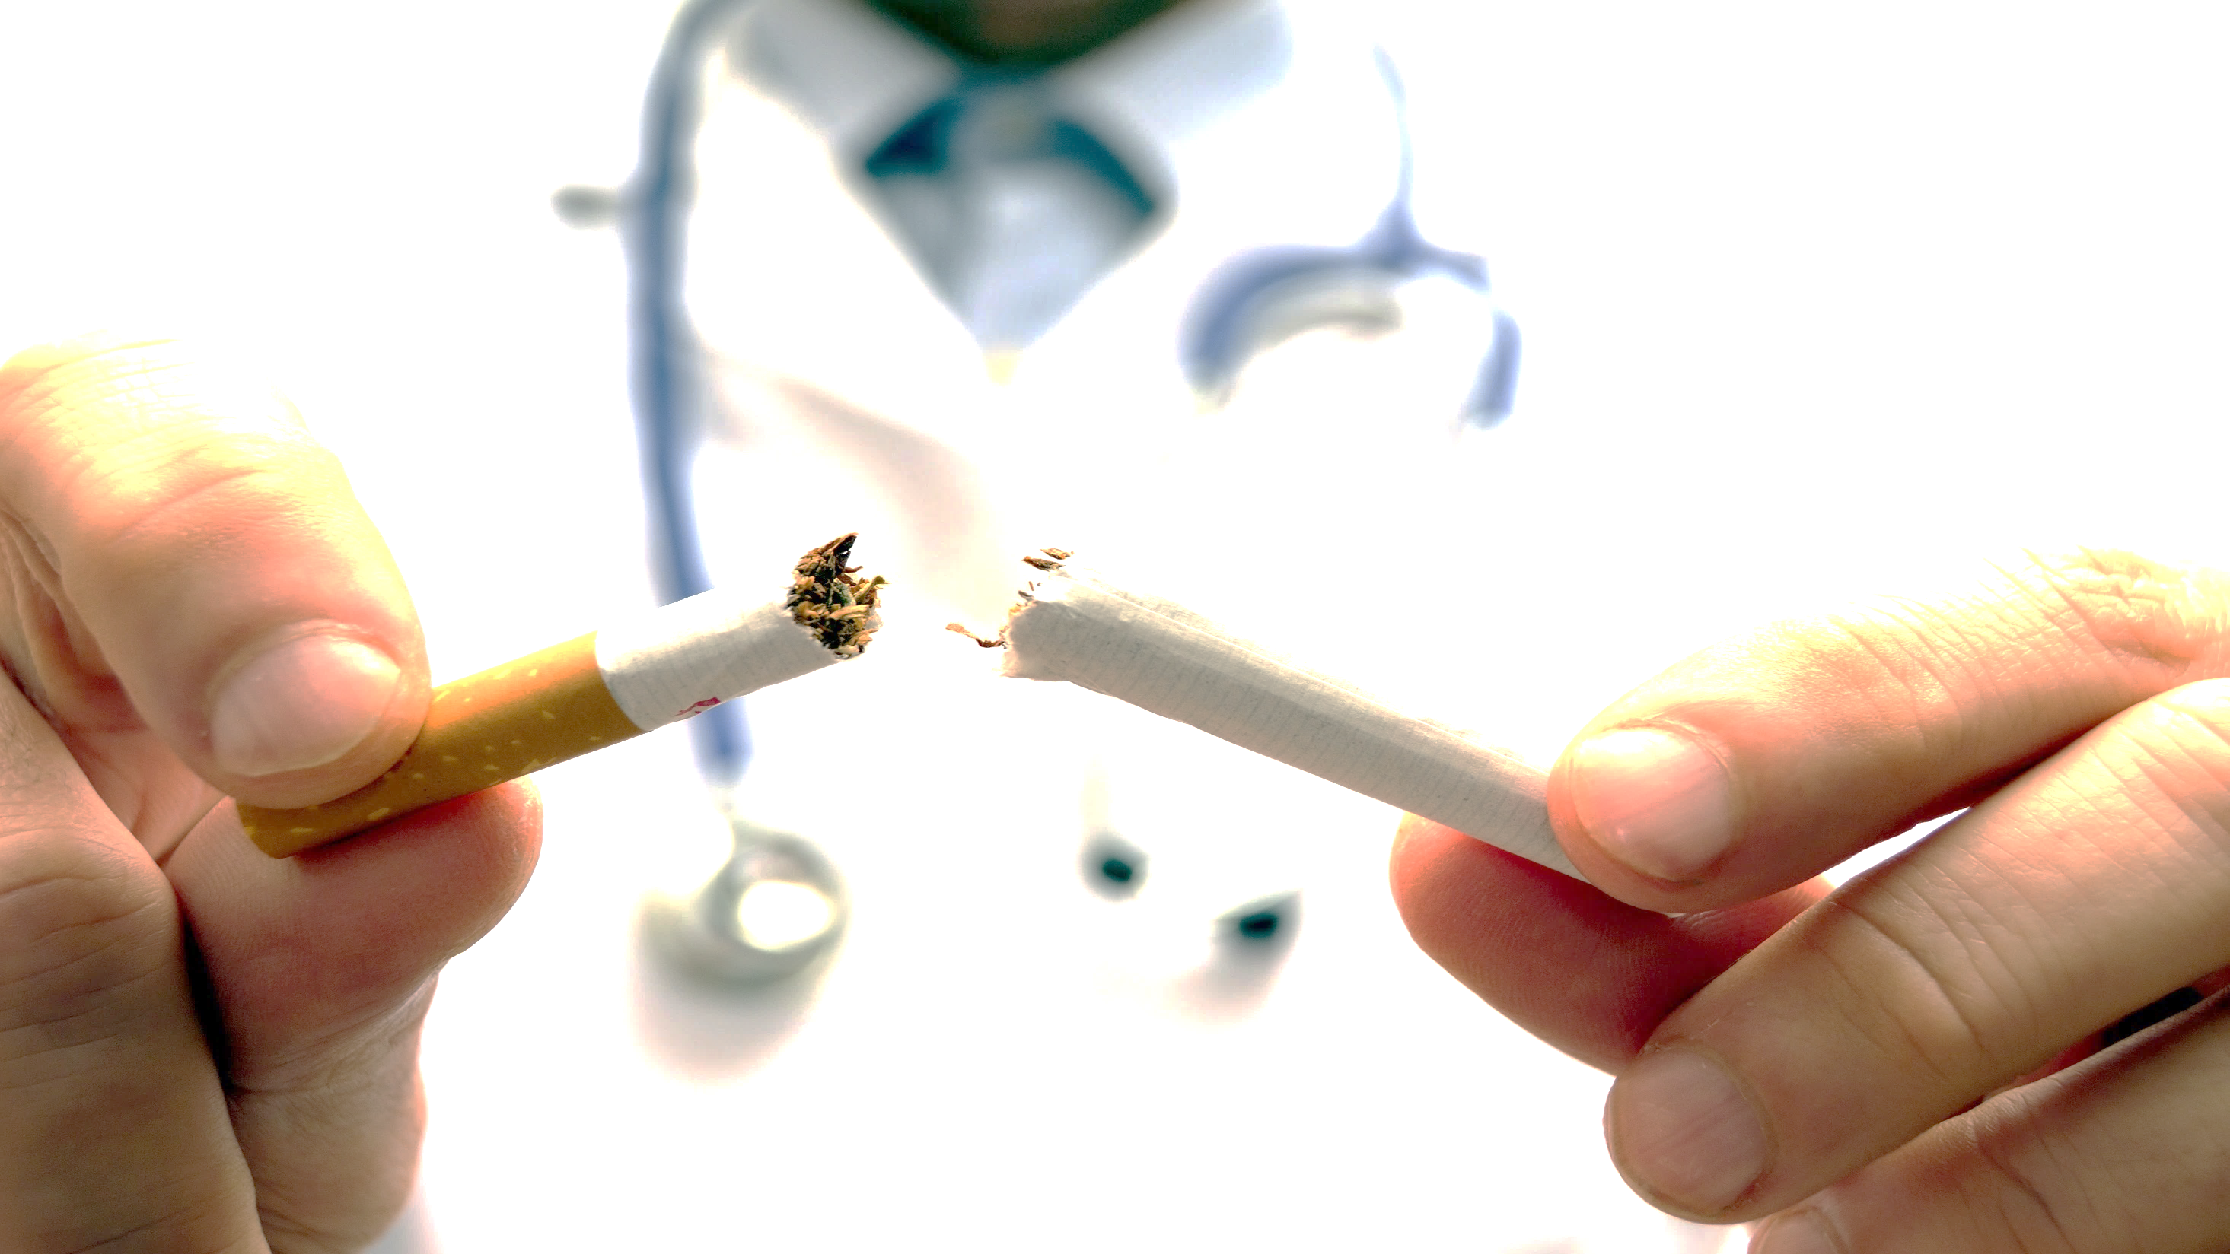
Quit Smoking. Cherish Your Life! 遠離煙草。 珍惜生命！

Slide 5
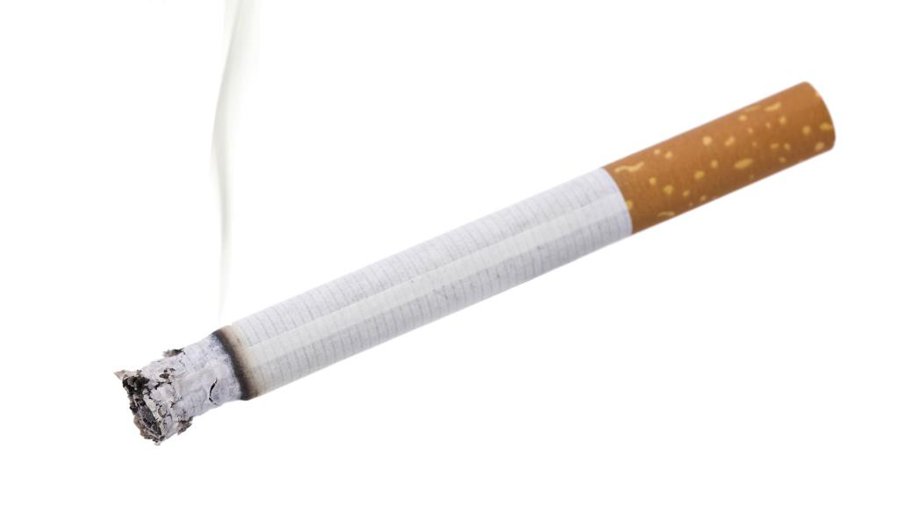
Did You Know? 你知道吗？
Cigarette smoking causes about 1 of every 5 deaths in the U.S. every year. It causes over 480,000 premature deaths annually!
* However, smoking is the #1 preventable cause of death!
每年在美國, 1/5 的死亡人仕是由吸煙引起的.
每年能導致超過 480,000 提早死亡！
* 然而，吸煙是第一個可預防的死因！

Slide 6
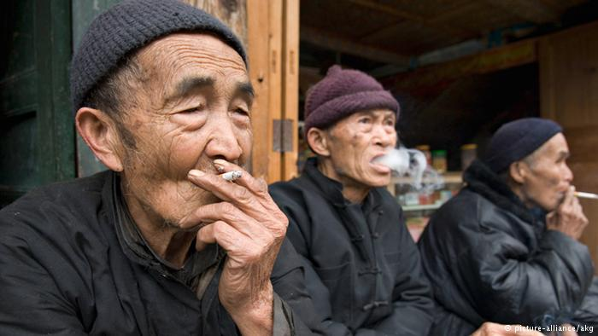
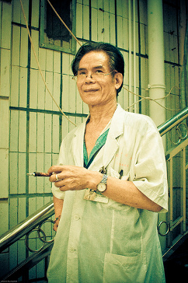
More than a third of the world’s smokers are Chinese. 世界上三分之一的吸煙者是中國人。
There are 350 million Chinese smokers. 3.5 億的中國人是吸煙者。
68% of Chinese men in China are smokers. 中國 68％ 男性是吸煙者。
A disproportionate number of male Chinese physicians in China are smokers. 在中國，大量的男性醫生都是吸煙者。

Slide 7
1-in-3 young Chinese men will die from smoking!
每 3 名年輕中國男性中會有 1 人因吸煙而死亡！

Slide 8
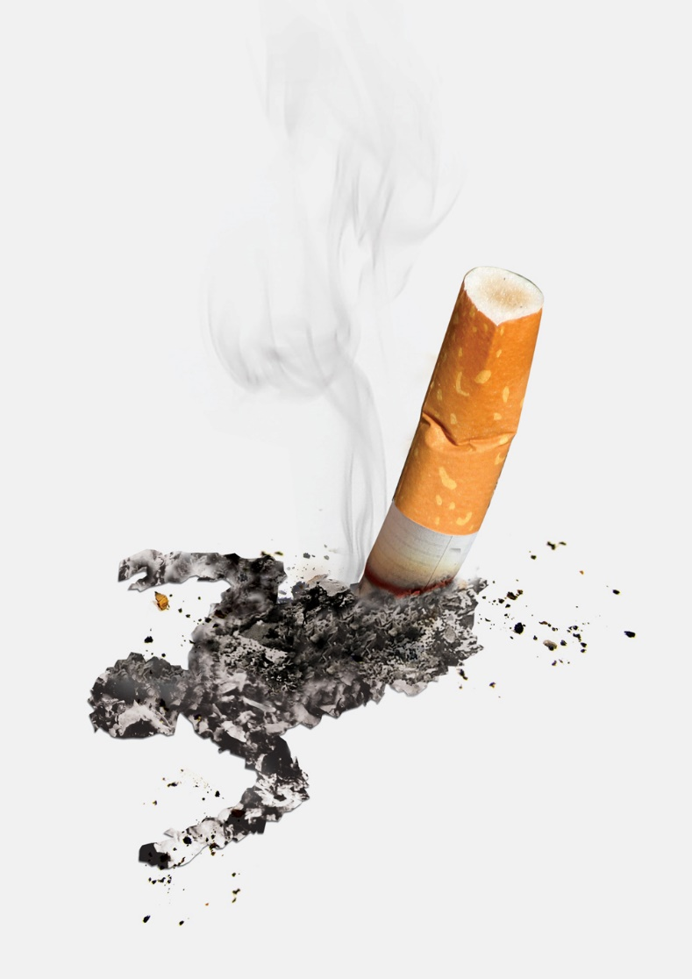
About 12,000 New Yorkers die every year due to smoking.
在紐約市，每年大約 12,000 人因吸煙而死亡。

Slide 9
Causes for Death 死亡的原因
Cancer is the #1 cause of death among Chinese in NYC and Lung Cancer is the #1 cause of cancer deaths for Chinese in NYC.
在紐約，癌症是華人排名第一的死因。而在這其中，肺癌的發生率在華人癌症患者中排名第一。

Slide 10
The smoking rate for Asian American men:
In New York City, it was 25.4% in 2015 – the highest rate for all major race and ethnic groups in NYC!
亞裔男子吸煙率:
紐約市在 2015 年為 25.4% – 為紐約市所有主要種族和族裔群體中的最高吸煙率。
NYCDOHMH Commissioner Dr. Mary T. Bassett, Epi Data Brief (June 28, 2017)

Slide 11
Lung cancer deaths…
Increased 70% among Chinese New Yorkers from 2000 to 2014 while decreasing 16.4% in NYC during the same period.
肺癌死亡…
2000 年至 2014 年期間，雖然紐約市的肺癌死亡人數下降16.4%，但同期紐約市華裔的肺癌死亡人數則增加七成。
NYCDOHMH Commissioner Dr. Mary T. Bassett, Epi Data Brief (June 28, 2017)

Slide 12
Cigarette smoking is the number one risk factor for lung cancer. In the US, 80-90% of lung cancers are linked to cigarette smoking.
吸煙是導致肺癌的首要因素。在美國，80%-90% 的肺癌患者都有吸煙的習慣。

Slide 13
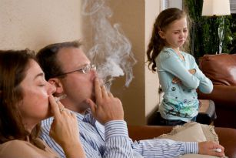
Smoking kills people around you! 吸煙害死你周圍的人！
There are 6 million tobacco-related deaths each year where 60,000 deaths are of non-smokers involuntarily exposed to secondhand smoke.
每年有六百萬例由與煙草有關而死亡。
然而，60,000 人的死亡是二手吸煙者。

Slide 14
What is Secondhand Smoke? 什麼是二手煙?
Secondhand smoke is a mix of the smoke from a cigarette and the smoke breathed out by a smoker.
Secondhand smoke has many harmful poisons that can cause asthma, heart disease, and cancer.
二手煙是一種混合煙霧，來自於煙草燃燒產生的煙霧和吸煙者呼出的煙霧。
二手煙含有多種有害有毒物質，這些物質可以導致很多疾病的產生，比如說哮喘，心臟病和癌症。

Slide 15
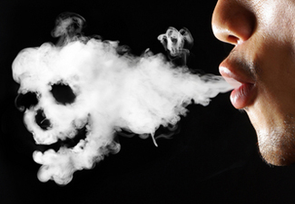
Dangers of Secondhand Smoke 二手煙的危險
A non-smoker can still get serious health problems from being around smoke.
Secondhand smoke causes approximately 34,000 early deaths from Coronary Heart Disease and 8,000 deaths from stroke. (Source: CDC)
儘管一個人從未吸過煙，但是如果長期遭受二手煙，這種煙霧仍然會對其身體健康帶來嚴重危險。
二手煙導致將近 34,000 的冠狀動脈疾病和 8,000 中風死亡。(Source: CDC)

Slide 16
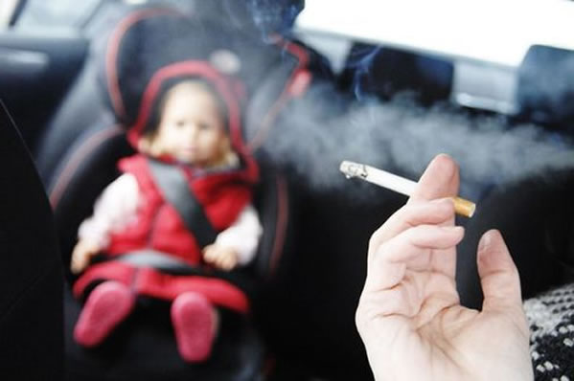
Secondhand smoke especially harms children 二手煙尤其危害兒童
Children’s bodies are still growing, so the smoke can hurt their heart and lungs as they develop.
在發育時期的兒童, 煙霧會傷害他們的內臟。
Protect your children from secondhand smoke! 保護你的孩子免受二手煙!

Slide 17
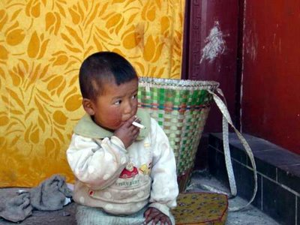
Secondhand Smoke is almost as bad as letting your child smoke! 孩子們吸入二手煙，就好比讓孩子們直接吸煙!

Slide 18
Being around secondhand smoke makes it more likely for children to get:
Lung and breathing issues
Sudden Infant Death Syndrome (SIDS)
Ear infections
Asthma
身處二手煙環境的兒童容易患以下的疾病：
肺和呼吸問題（特別是 6 歲以下的兒童）
嬰兒猝死綜合症
耳部感染
哮喘（二手煙會惡化）

Slide 19
Prevent Third-hand Smoke, Too 亦要防止三手煙
Third-hand smoke: Cigarette smoke and its chemicals will stick around even after you stop smoking.
It stays in your hair, skin, clothes, carpet, walls, and furniture for months or longer.
Cannot be removed by airing out a room or even cleaning.
Children and adults can be put at risk for health problems just by breathing near or touching surfaces with third-hand smoke.
三手煙: 在你停止吸煙後，香煙的煙霧和其中的化學物質仍然會長久無法散去。
吸煙所產生的煙霧和化學物質會附著你的頭髮，皮膚，衣服，地氈，家具甚至牆壁上。
其吸附效應會長達數月甚至更久，即使你停止吸煙或讓空氣散出甚至清掃都是無法根除的。
成人或者兒童會因為吸入三手煙所產生的化學物質而對身體產生影響，進而威脅到健康。

Slide 20
Prevent Third-hand Smoke, Too 亦要防止三手煙
To further protect your children from cigarette smoke:
Choose not to smoke in your home or car.
Take a shower or change your clothes before touching or going near your children.
保護您的孩子免受吸煙：
選擇不要在家裏或汽車內吸煙。
在接觸或靠近你的孩子之前要洗澡或換衣服。

Slide 21
Why is smoking bad for you?
為什麼吸煙
有害健康？

Slide 22
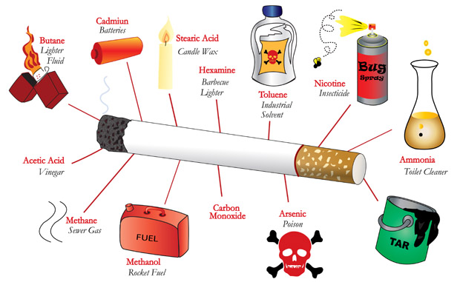
Over 7,000 toxic CHEMICALS - 70 are known to cause cancer!!! 在超過 7,000 種的毒性化合物內有 70 能導致癌症!!!

Slide 23
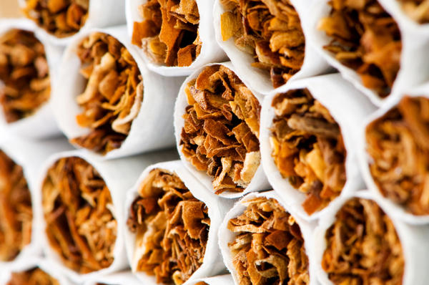
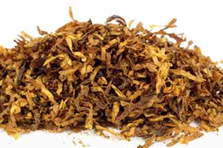
Nicotine 尼古丁
Highly addictive
高度上瘾
Acts on brain within 15 seconds
在 15 秒內就能影響大腦
Affects mood and behavior
影響情緒和行為

Slide 24
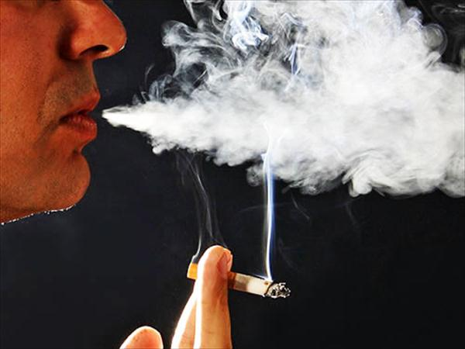
Carbon Monoxide 一氧化碳
Poisonous gas absorbed into blood
毒氣體會溶入血液
Reduces muscle and heart functions
減少肌肉和心臟功能
Causes fatigue, weakness, and dizziness
會導致疲勞，虚弱，和暈眩

Slide 25
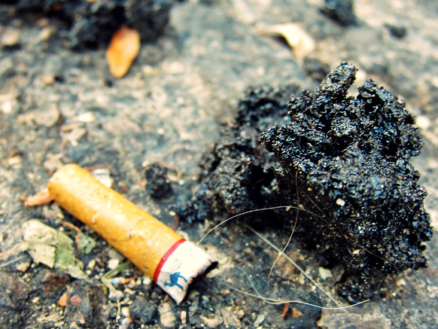
Tar 煙焦油
Has chemicals that can cause cancer
有化合物能導致癌症
70% remains in lungs
70％ 被困在肺部

Slide 26
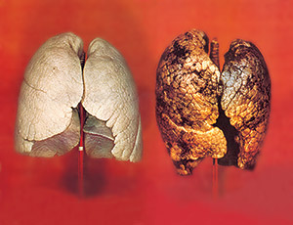
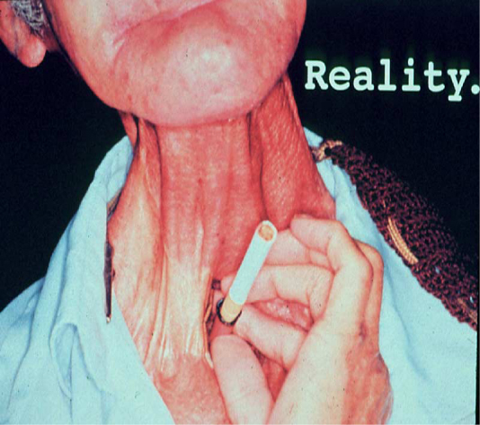
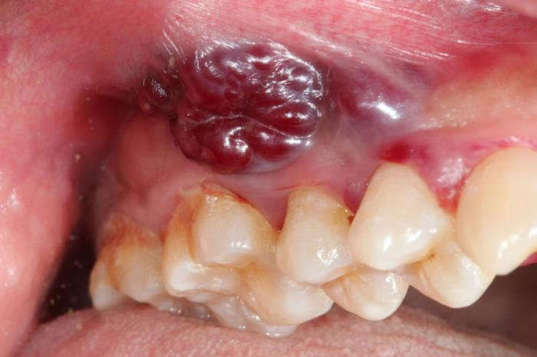
Cancer 癌症
Smoking
Causes:
吸煙能導致
Lung cancer
肺癌
Throat cancer
咽喉癌
Mouth cancer
口腔癌

Slide 27
Cancer 癌症
Smoking
Causes:
吸煙能導致
Esophagus 食管
Bronchus 支氣管
Stomach 腸胃
Kidney 腎
Renal 腎
Colon 結腸
Pelvis 盆腔
Rectum 直腸
Urinary bladder 膀胱
Liver 肝
Cervix 子宮頸
Pancreas 胰腺
Acute myeloid leukemia
急性骨髓性白血病
Voice box (Larynx) 喉
Trachea 氣管

Slide 28
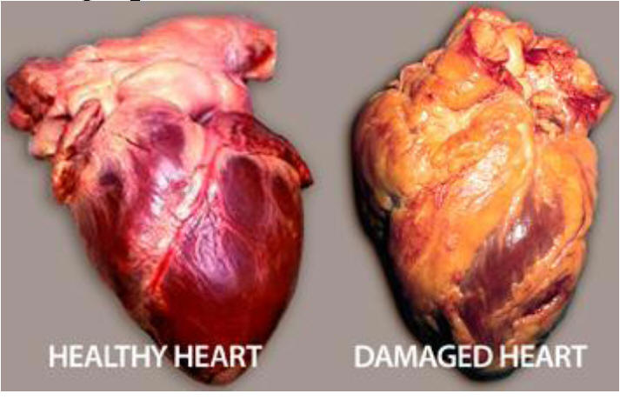
Heart Disease 心臟病
Smoking Causes:
吸煙能導致
Atherosclerosis → blocks blood flow
動脈粥樣硬化 → 阻止血液流動
Raises blood pressure and blood clots
提高血壓和引起血凝塊

Slide 29
Smoking Causes:
吸煙能導致
Heart Disease 心臟病
Smokers are two times more likely to develop heart disease than non-smokers.
與非吸煙者相比，吸煙者發生心臟病的可能性高出兩倍。
Other heart diseases: 其它心臟病
Peripheral artery disease 外周動脈疾病
Abdominal aortic aneurysm 腹主動脈瘤

Slide 30
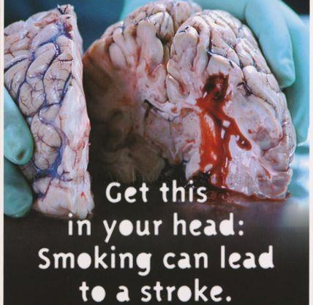
Stroke 中風
Smoking Causes:
吸煙能導致
Men who smoke more than a pack a day of cigarettes also at greatly increased risk of stroke.
每天吸煙超過一包的男性也大大增加了中風的風險。

Slide 31
Smoking Causes:
吸煙能導致
Stroke 中風
Smoking makes blood sticky and clots are more likely to form. It also increase plaque build up in your arteries. These are the right conditions for a stroke to occur.
吸烟会使血液粘稠度增高，促使血液中形成血液凝块。吸煙能導致動脈斑塊在頸動脈的積累。這些狀況都能使中風的發生。

Slide 32
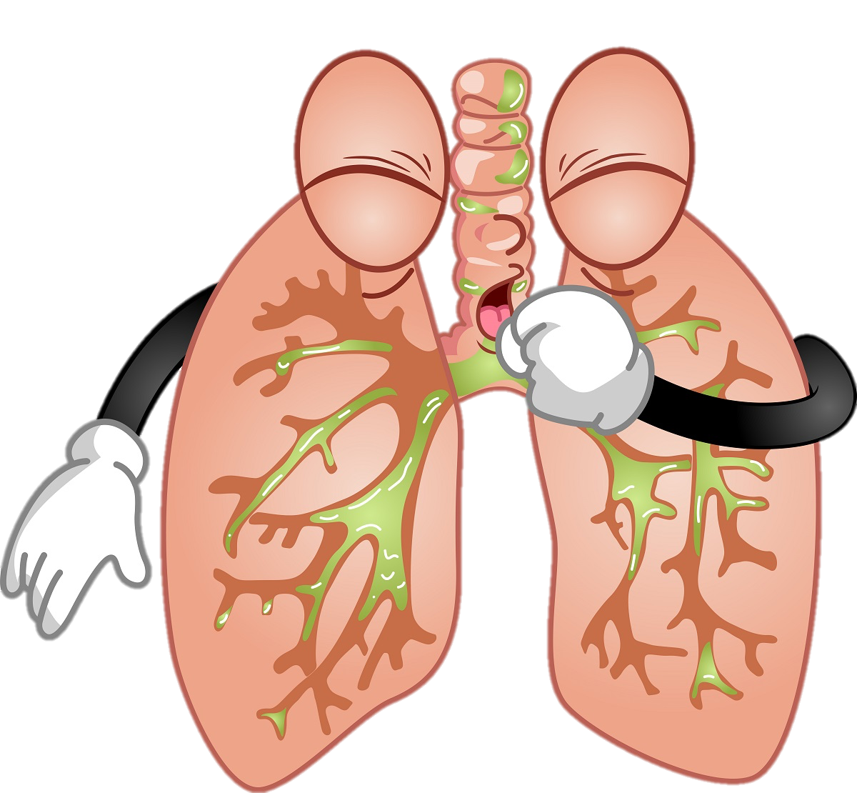
Smoking Causes:
吸煙能導致
Lung and Breathing issues: (費和呼吸問題)
Asthma (哮喘)
Chronic Obstructive Pulmonary
Disease (慢性阻塞性肺病)
Chronic Bronchitis (慢性支氣管炎)
Emphysema (肺氣腫)

Slide 33
Finally… 最後…
Smokers die 10 years earlier than non-smokers.
吸煙者比非吸煙者提早死亡10年。

Slide 34
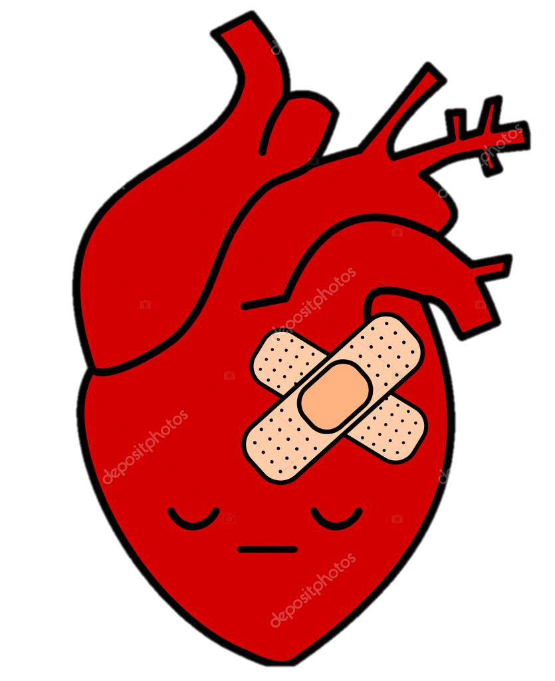
Smoking is a major cause of Heart Disease and causes one out of every 3 deaths. 吸煙是心臟病的主要原因，導致每三分之一的病例死亡。
Notes:
Source Center for Disease Control and Prevention https://www.cdc.gov/tobacco/campaign/tips/diseases/heart-disease-stroke.html

Slide 35
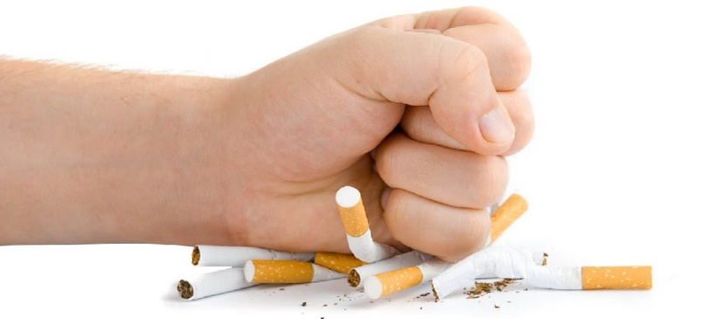
Reasons To Quit Smoking
戒煙原因

Slide 36
Quitting Is Possible 戒煙是可能的
It’s Never Too Late To Quit
戒煙永遠不會太遲
Protect Your Loved Ones 保護你關愛的人

Slide 37
Quitting: Health Benefits 戒煙: 健康好處
Short-Term Benefits 短期好處 Blood circulation improves 血液循環改善 Walking becomes easier 行走變得容易 Less coughing, fatigue, shortness of breath 少咳嗽，疲勞，氣促 Decreased risk of coronary heart disease (CHD) 降低冠心病風險 | Long-Term Benefits 長期好處 Decreased risk of cancer of lung, mouth, throat, esophagus, bladder, kidney, and pancreas 降低肺，口腔，咽喉，食管，膀胱，腎臟和胰腺癌的風險 Decreased risk of stroke 降低中風險 Reduced lung cancer death rate 降低肺癌死亡率

Slide 38
Quit Today!!! 今天戒煙吧!!! People of all ages who have already developed smoking-related health problems can still benefit from quitting. 因吸煙而患上健康問題之人仕，無論在任何年齡及時戒煙都能得益。

Slide 39
Age of Quitting Smoking 戒煙的年齡 | Benefits in Comparison with Those Who Continued 戒煙者與繼續吸煙者相比之益處
At about age 30 大约 30 歲 | Gain almost 10 years of life expectancy 增益 10 年的壽命
At about age 40 大约 40 歲 | Gain 9 years of life expectancy 增益 9 年的壽命
At about age 50 大约 50 歲 | Gain 6 years of life expectancy 增益 6 年的壽命
At about age 60 大约 60 歲 | Gain 3 years of life expectancy 增益 3 年的壽命
After the onset of life threatening disease 在有威脅生命的疾病發作後 | Rapid benefit, people who quit smoking after having a heart attack reduce their chances of having another heart attack by 50%. 患上心肌梗塞之人仕，在戒煙後能降低 50% 復發機會。

Slide 40
Quitting: For Your Family 戒煙: 為你的家人
Be with your family longer!
你們與家人生活更長時間！
By going smoke-free, you could improve the well-being of both you and your loved ones!
戒煙後，你可以改善你及親人的健康，增進幸福。

Slide 41
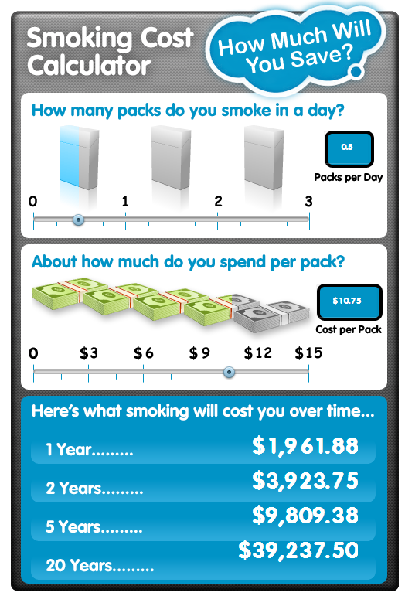
Quitting: Save Money 戒煙: 省錢
Think about all the money you save from quitting. $$$
想一想你戒煙後所能省下的錢。$$$
½ pack a day smoker spending $10.75 per pack
一天半包
吸煙者一包煙花 $10.75

Slide 42
Tips To Quit Smoking 戒煙的要訣
Make a plan: keep your hands busy and mind off cigarettes.
制定計劃： 保持雙手忙碌 轉移煙 癮 的注意力。
1
Make your home and car smoke-free.
把你的住所及汽車變成禁煙區。
2
Get support: talk to your family and friends about your plan to quit.
尋求支持：與親友談論你正在計劃戒煙，讓他們知道可以怎麼樣幫助你。
3
Use a quitting aid: nicotine patches and gum.
選用 戒煙尼古丁代替品： 膠貼及口香膠。
4
Call (800) 838-8917: a trained advisor who CAN OFFER SUPPORT.
致電戒煙專線 (800) 838-8917)： 受過專業訓練的顧問會幫助你做一個適合你個人的戒煙計劃。
5

Slide 43
Reasons for Using Nicotine Replacement Therapy (NRT) 用尼古丁替代療法 (NRT) 的原因
It works – roughly doubling success rates.
增加效果 – 大概是成功率的一倍。
It helps the person feel more comfortable:
能使人感覺更舒服:
Treats nicotine withdrawal syndrome.
治療尼古丁戒斷綜合徵。
It is safe – the smoker is getting “clean” nicotine instead of “dirty” nicotine with 7000+ chemicals.
安全 - 吸煙者使用的是 “乾淨” 的尼古丁而不是包含著 7000 多種有毒性化合物的尼古丁。

Slide 44
Key Points about Nicotine Replacement Therapy (NRT) 關於尼古丁替代療法 (NRT) 的要點
Nicotine and NRT do not cause cancer.
尼古丁和尼古丁替代療法不會導致癌症。
Nicotine does not cause tobacco-related diseases; rather it is the toxins found in cigarettes, and not the nicotine, that causes the negative health effects.
尼古丁不會導致與煙草有關的疾病； 對健康造成負面影響是香煙中的毒素而不是尼古丁。
NRT can be safely used by people with diabetes or high blood pressure and does not increase the risk of heart attacks.
有糖尿病或高血壓的患者能安全使用尼古丁替代療法而不會增加心臟病發作的風險。
NRT does not cause weight gain, but nicotine may actually help control weight.
尼古丁替代療法不會增加體重，而實際上可以幫助控制體重。
http://smokefree.gov/sites/default/files/pdf/mythsaboutNRTfactsheet.pdf

Slide 45
Lung Cancer Screening with Low-Dose Computed Tomography (LDCT) 肺癌篩查使用低劑量 CT
During an LDCT scan, you lie on a table and an x-ray machine uses a low-dose of radiation to make detailed images of your lungs. It only takes a few minutes and is not painful.
進行 LDCT 掃描的時候，人需要躺在檢測台上，一台儀器會發出低劑量的 X 射線，來拍攝肺部的圖像。這個過程是無痛的，並且只需要幾分鐘的時間。
It is currently the only recommended screening strategy for lung cancer.
是目前唯一推薦的肺癌篩查的方法。
*** Best way to lower chances of dying from lung cancer is to stop smoking. ***
*** 降低肺癌死亡幾率的最好辦法是戒煙。 ***

Slide 46
Who should be screened? 誰應該檢查?
The United States Preventive Services Task Force (USPSTF) recommends lung cancer screening for individuals who:
Are 55 to 80 years old
No signs or symptoms of lung cancer
No history of lung cancer
Currently smoke or quit less than 15 years ago
Are or were considered heavy smokers (30 pack-years history)
美國預防服務工作隊 (USPSTF) 建議一下人員進行肺癌篩查:
55 至 80 歲
沒有肺癌的症狀
沒有肺癌史
目前吸煙或戒煙不到15年前
被認為是重吸煙者（ 三十包年吸煙 ）

Slide 47
Eligibility for lung cancer screening 肺癌篩查的資格
Talk with your health care professional to decide whether screening is right for you.
請經過專業醫護人員諮詢後決定射線檢測是否合適。
Private insurance plans cover lung cancer screening for people age 55 to 80, without pocket expenses.
私人醫療保險可以提供肺癌篩查的全部費用給 55 至 80 歲之間的人群。
Medicare pays for lung cancer screening with no out-of-pocket costs for people from age 55 to 80 as long as you have a written order from your health care professional and shared decision-making visit with them.
紅藍卡 醫療保險可以提供肺癌篩查的全部費用給 55 至 80 歲之間的人群。患 者需要經過專業醫護人員的諮詢，並且持有該醫護人員開具的篩查處方。

Slide 48
Resources For Smokers 給吸煙者的幫助與支持
NYCDOHMH – NYC Quits
www.nyc.gov/nycquits
Prescription Help:
Medicaid
Big Apple

Slide 49
Asian Smokers' Quitline 華語戒煙專線
服務包括:
免費的戒煙輔導服務。
無限的中文，韓文和越南語輔導。
兩星期的免費尼古丁貼片。
語言專線
服務時間: 星期一到五
11am – 12am 西岸時間
Services include:
Free telephonic smoking cessation counseling.
Unlimited counseling sessions in Chinese, Korean, & Vietnamese.
Free 2-week starter-kit of nicotine patches.
Direct Language Lines
Hours: Monday - Friday
11am – 12 am EST

Slide 50
Quit Smoking Resources List by Region 戒煙資源按地區排列 USA Nationwide 全美國
1
Organization 機構 | Services 服務 | Hours of Operation 服務時間 | Contact Info 聯絡方式
Nationwide (U.S.) Asian Smokers’ Quitline 華語戒煙專線 | A free nationwide Asian-language phone quit smoking service. They offer self-help materials, local program referrals, one-on-one telephone counseling, and free nicotine replacement therapies sent to their home. 全國的亞洲語言戒菸熱線，我們提供自助材料、社區項目推薦、一對一電話諮詢並可將免費的 “尼古丁替代療法” 送到你家。 | Monday to Friday, 7am-9pm, Pacific Time 星期一到五, 7am-9pm 太平洋標準時間 | Mandarin, Cantonese (國語, 粵語): 1-800-838-8917 Korean (韓語): 1-800-556-5564 Vietnamese (越南語): 1-800-778-8440

Slide 51
Quit Smoking Resources List by Region 戒煙資源按地區排列 New York City 紐約市
4
Organization 機構 | Services 服務 | Hours of Operation 服務時間 | Contact Info 聯絡方式
New York City Asian Americans for Equality (AAFE) 亞洲人平等會 | A community-based organization that offers free individual counseling, help developing a quit plan, and free nicotine replacement therapy if eligible. 我們是一個社區性的組織，在這裡我們將提供免費的個人戒菸諮詢，制定戒菸計劃。符合條件者，我們將提供免費的 “尼古丁替代療法”。 |  | English, Mandarin, Cantonese (英文, 國語, 粵語): 1-212-979-8988
Charles B. Wang Community Health Center (CBWCHC) 王嘉廉社區醫療中心 | A community health center that offers free in person and phone counseling to patients and community members by a trained health coach and offers free nicotine patches and gum for eligible smokers. 我們是一個社區健康中心，提供免費的來訪及電話諮詢，社區成員也可接受健康訓練。同時，符合條件者，我們將為吸煙者提供免費的 “尼古丁替代療法”。 |  | English, Mandarin, Cantonese (英文, 國語, 粵語): 1-212-966-0461

Slide 52
Quit Smoking Resources List by Region 戒煙資源按地區排列 New York State 紐約州
5
Organization 機構 | Services 服務 | Hours of Operation 服務時間 | Contact Info 聯絡方式
New York Smokers’ Quitline 紐約州吸煙者幫助熱線 | One-to-one counseling with help developing individualized quit plan. Free nicotine replacement therapy if eligible. 一對一的諮詢服務幫助您制定戒菸計劃。符合條件者，我們將提供免費的 “尼古丁替代療法”。 |  | Website (網站): www.nysmokefree.com English (英文): 1-866-697-8487

Slide 53
Questions
提問時間

Slide 54
Thank you!
謝謝參加！

